Slide 1

Steps to Start a Podcast: A Comprehensive Guide
Essential steps for launching your own podcast
Notes:
AI-generated content may be incorrect. --- Podcasting has become a popular medium for sharing ideas, stories, and information. In this presentation, we will cover essential steps to help you start your own podcast, from planning and production to improving your speaking skills.

Slide 2
Agenda for Podcast Creation
Planning Your Podcast
Editing and Production
Practice Speaking Clearly
Notes:
We will first discuss the planning phase of your podcast, including defining its purpose, identifying your audience, and choosing the right format. Next, we will explore editing and production techniques to enhance your episodes. Finally, we will cover the importance of clear speaking and techniques to improve your vocal delivery.

Slide 3
Planning Your Podcast
Notes:
Effective planning lays the foundation for a successful podcast. By carefully considering your podcast's purpose, audience, and structure, you can create engaging content that resonates with listeners.

Slide 4

Defining Your Podcast's Purpose and Niche
Identify Your Passions
Begin by identifying topics that excite you, as passion is crucial for maintaining long-term engagement with your podcast.
Determine Your Value
Clarify the value your podcast will bring to listeners, which can help differentiate your show from others.
Establish Clear Purpose
A clear purpose will guide your content creation, ensuring that each episode aligns with your overall goals.
Notes:
Start by identifying what topics you are passionate about and what value your podcast will bring to listeners. A clear purpose and niche will help guide your content and attract a dedicated audience.

Slide 5

Identifying Your Target Audience
Importance of Audience Understanding
Knowing your target audience helps in creating relevant and engaging content that resonates with them.
Research Demographics
Researching demographics allows you to tailor content based on age, gender, location, and other factors.
Identifying Interests
Understanding the interests of your audience helps in curating content that meets their preferences and needs.
Listening Habits
Analyzing listening habits enables you to determine the best formats and platforms for your content.
Notes:
Understanding your target audience is crucial for creating relevant content. Research demographics, interests, and listening habits to tailor your episodes to their preferences and needs.

Slide 6

Choosing a Podcast Format and Structure
Podcast Format Types
Choose a podcast format that suits your content, such as interview-based, narrative storytelling, or roundtable discussions.
Episode Structure
Plan the structure of each episode, including segments that create a flow and keep the audience engaged throughout.
Consistency in Release
Establish a consistent release frequency for your podcast to build an audience and maintain listener interest.
Notes:
Decide on the format of your podcast, whether it will be interview-based, narrative, or a roundtable discussion. Determine the structure of each episode, including segments, duration, and release frequency, to maintain consistency.

Slide 7
Editing and Production
Notes:
Once you've recorded your episodes, editing and production are vital to enhance audio quality and overall listener experience. This section will provide insights into effective techniques and tools for editing.

Slide 8
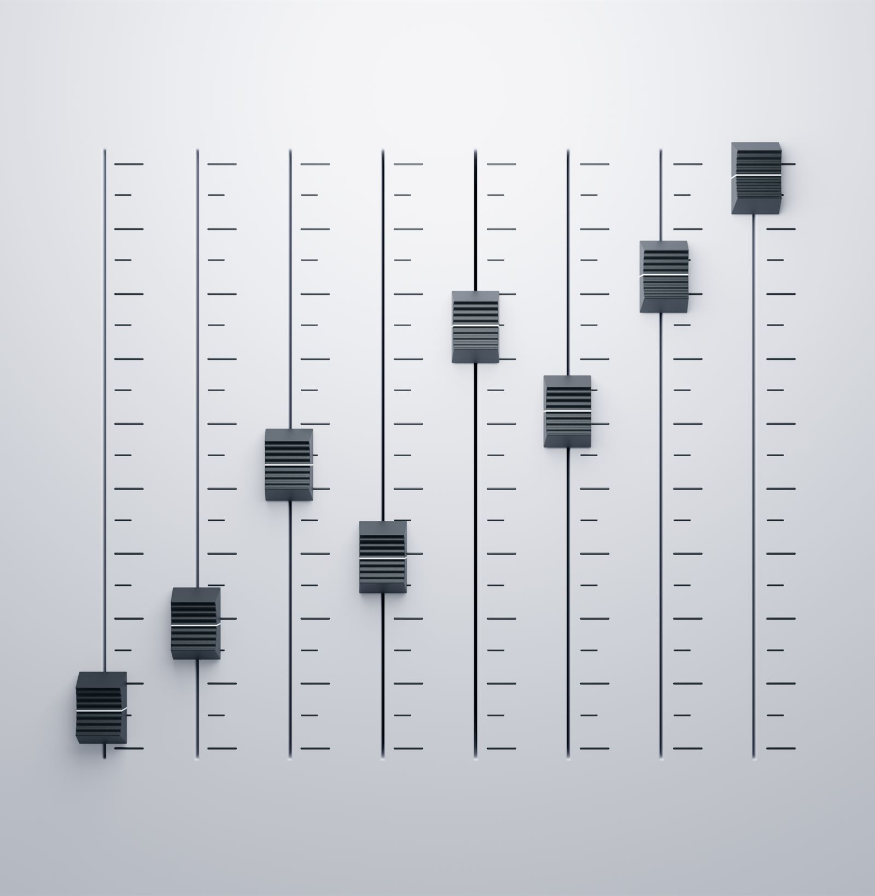
Basic Editing Techniques and Software Options
Basic Editing Techniques
Learn fundamental editing techniques like trimming, cutting, and adjusting audio levels for better sound quality.
Software Options
Explore various audio editing software options to determine which one best suits your editing needs and preferences.
Notes:
Familiarize yourself with basic editing techniques, such as trimming, cutting, and adjusting audio levels. Explore software options like Audacity, GarageBand, or Adobe Audition to find the best fit for your needs.

Slide 9
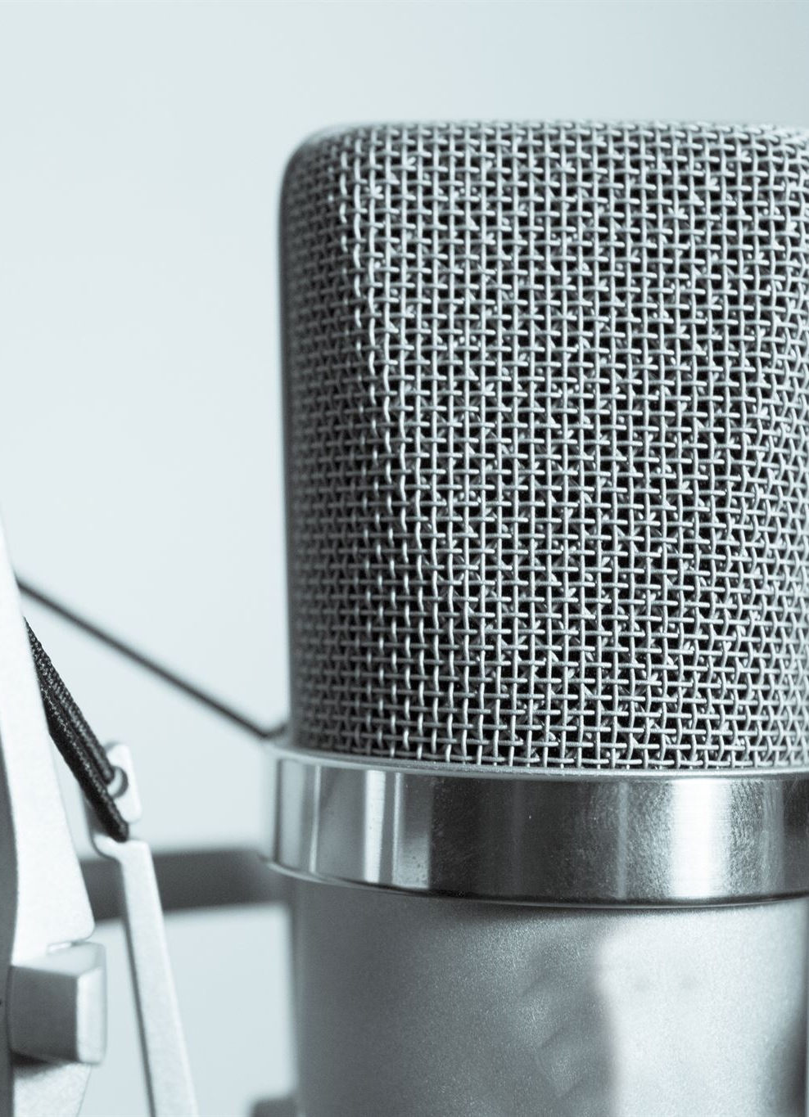
Adding Music and Sound Effects
Enhancing Atmosphere
Music and sound effects can significantly enhance the atmosphere of your podcast, making it more engaging for listeners.
Choosing Royalty-Free Audio
Opt for royalty-free audio to maintain originality in your podcast and avoid copyright complications.
Creating Custom Sound Bites
Custom sound bites can personalize your podcast, giving it a unique touch that resonates with your audience.
Notes:
Incorporating music and sound effects can enhance your podcast's atmosphere and engage listeners. Choose royalty-free audio or create custom sound bites to maintain originality and avoid copyright issues.

Slide 10

Finalizing and Exporting Your Episodes
Audio Quality Finalization
Ensure that your audio is clear and professionally polished before finalizing your episodes for distribution.
Export Format Selection
Select the appropriate audio format and quality settings that comply with podcast platform requirements for optimal distribution.
Distribution Preparation
Prepare your episodes for distribution by ensuring they meet the technical specifications of various podcast platforms.
Notes:
After editing, finalize your episodes by ensuring the audio is clear and professionally polished. Export your episodes in the appropriate format and quality for distribution on various podcast platforms.

Slide 11
Practice Speaking Clearly
Notes:
Clear articulation is essential for effective communication in podcasting. This section focuses on various techniques to improve your speaking skills, ensuring your message is conveyed effectively.

Slide 12

Importance of Clear Articulation
Enhances Understanding
Clear articulation ensures that the audience grasps the message without confusion, leading to better communication.
Builds Credibility
When you articulate clearly, it enhances your credibility as a speaker, making your audience trust your message more.
Keeps Audience Engaged
Articulating your message clearly keeps your audience engaged and interested in your podcast episodes.
Notes:
Clear articulation helps listeners understand your message without confusion. It enhances your credibility and keeps audiences engaged throughout your podcast episodes.

Slide 13
Techniques for Improving Enunciation
Tongue Twisters Practice
Tongue twisters are fun and effective exercises to enhance clarity and precision in speech.
Slow Speech Techniques
Practicing slow speech allows you to articulate words clearly and improves overall enunciation.
Focus on Pronunciation
Focusing on correct pronunciation helps develop clearer speech patterns and boosts self-confidence.
Notes:
Practice techniques such as tongue twisters, slow speech, and focusing on pronunciation to improve your enunciation. Regular practice will help you sound more confident and articulate.

Slide 14
Exercises for Vocal Clarity
Breathing Techniques
Incorporating breathing exercises helps improve lung capacity and control, essential for clear vocal delivery.
Pitch Modulation
Practicing pitch modulation enhances vocal variety and expressiveness, making speech more engaging for the audience.
Vocal Warm-Ups
Regular vocal warm-ups prepare the voice for speaking or singing, leading to improved vocal quality and endurance.
Notes:
Incorporate vocal exercises like breathing techniques and pitch modulation into your routine. These exercises can enhance your vocal quality and overall delivery, making your podcast more enjoyable.

Slide 15
Conclusion
Careful Planning
Effective podcasting begins with careful planning, including topic selection and audience understanding for greater impact.
Effective Production
High-quality production is essential; focus on sound quality, editing, and presentation to engage listeners.
Clear Communication
Clear communication with your audience fosters connection and retention, essential for a successful podcast.
Notes:
Starting a podcast involves careful planning, effective production, and clear communication. By following these steps and continuously improving your skills, you can create a podcast that resonates with your audience and stands out in the crowded space.

